Slide 1
Bit 302 software enggineering
Group Name:
Luh Wulandari Maharani (E1700873)
Rivaldo Bagus Soepardhy (E1700882)

Slide 2
Introduction
Every software development must have a clear and understandable requirement or specification to ensure developers can keep developing software within the boundary of requirement, while also, developer can adjust to what users need with the software, and developers can optimize the software according to users’ need.

Slide 3
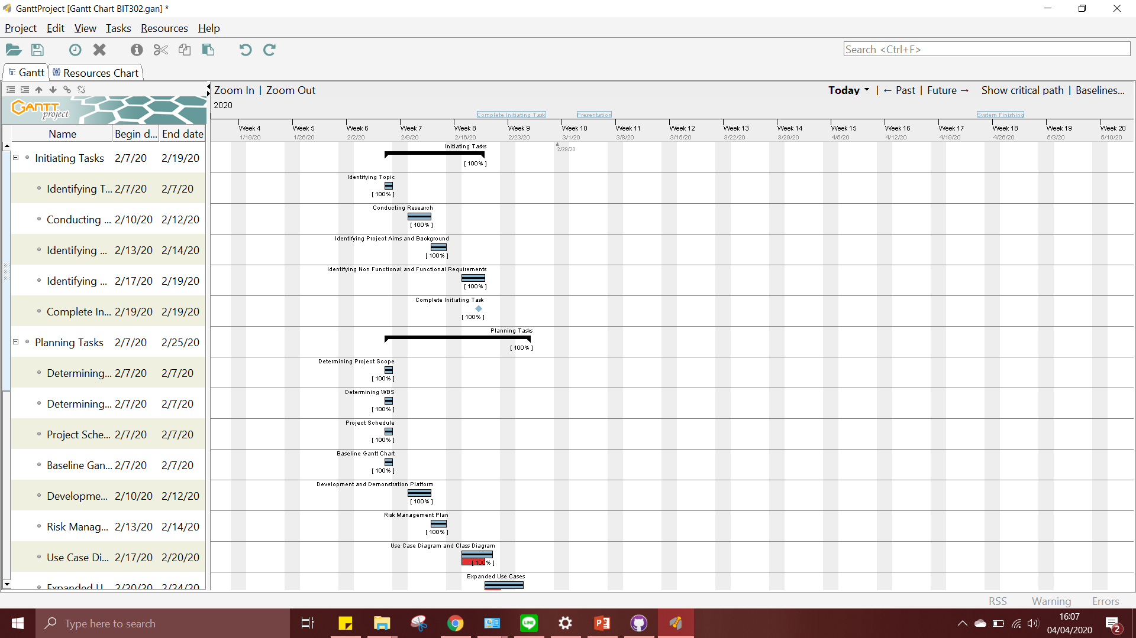
Gantt Chart

Slide 4
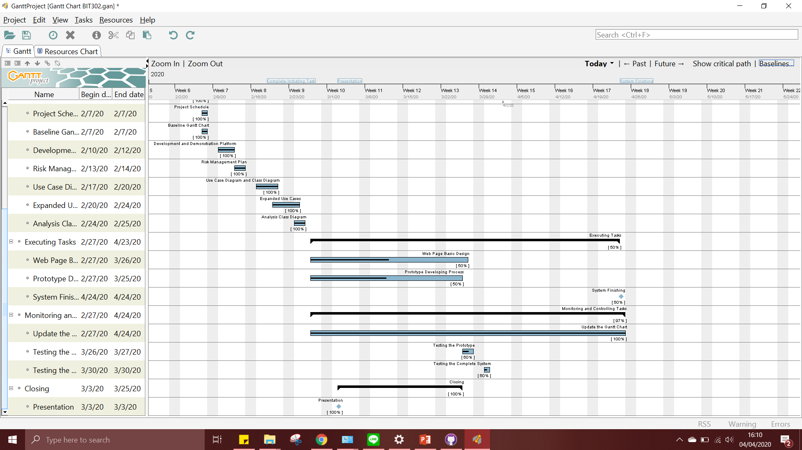
Gantt Chart

Slide 5
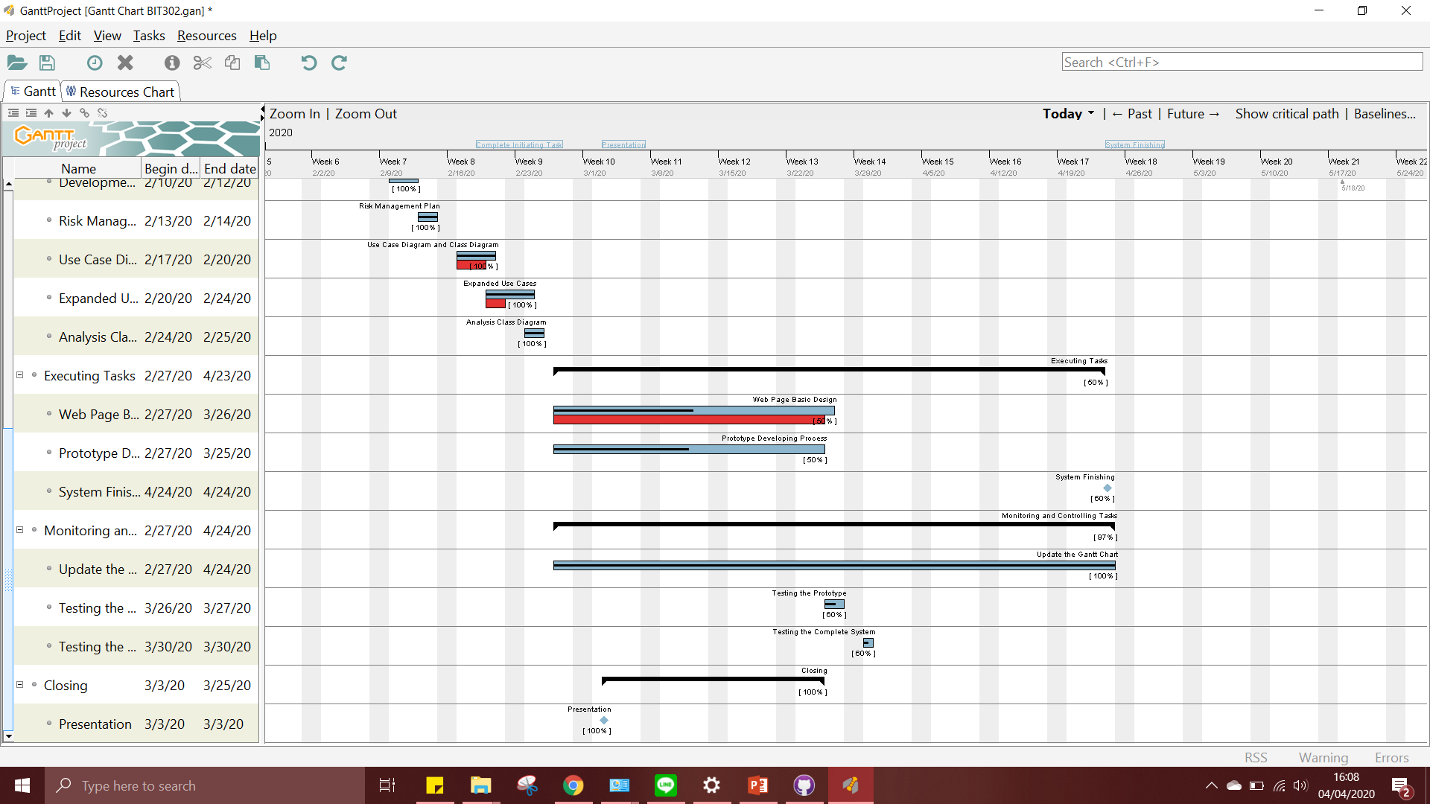
Baseline Gantt Chart

Slide 6
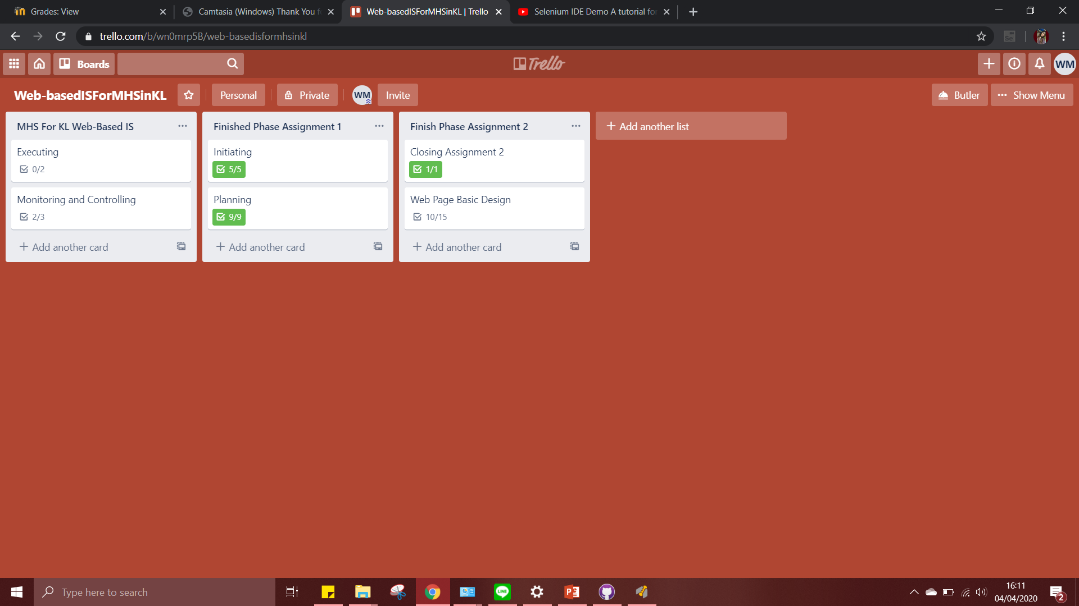
Trello

